Slide 1
HNDIT2312-Principles of Software Engineering
Week 1: Introduction to Software Engineering

Slide 2
Topics covered
Professional software development
What is meant by software engineering.
Software engineering ethics
A brief introduction to ethical issues that affect software engineering.
Case studies
An introduction to three examples that are used in later chapters in the book.

Slide 3
Software engineering
The economies of ALL developed nations are dependent on software.
More and more systems are software controlled
Software engineering is concerned with theories, methods and tools for professional software development.
Expenditure on software represents a significant fraction of GNP in all developed countries.

Slide 4
Software costs
Software costs often dominate computer system costs. The costs of software on a PC are often greater than the hardware cost.
Software costs more to maintain than it does to develop. For systems with a long life, maintenance costs may be several times development costs.
Software engineering is concerned with cost-effective software development.

Slide 5
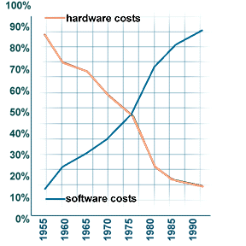
Hardware vs Software

Slide 6
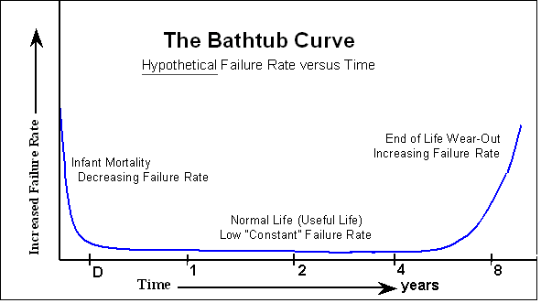
Hardware Cost

Slide 7
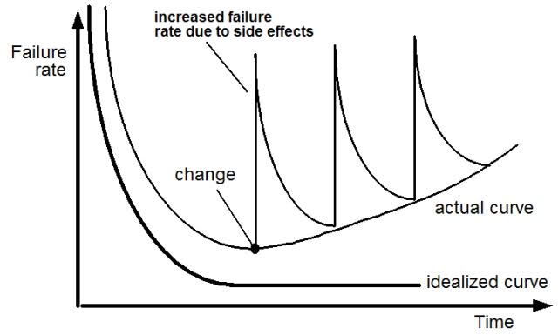
Software Failure Rate

Slide 8
Software products
Generic products
Stand-alone systems that are marketed and sold to any customer who wishes to buy them.
Examples – PC software such as graphics programs, project management tools; CAD software; software for specific markets such as appointments systems for dentists.
Customized products
Software that is commissioned by a specific customer to meet their own needs.
Examples – embedded control systems, air traffic control software, traffic monitoring systems.

Slide 9
Frequently asked questions about software engineering
Question | Answer
What are the key challenges facing software engineering? | Coping with increasing diversity, demands for reduced delivery times and developing trustworthy software.
What are the costs of software engineering? | Roughly 60% of software costs are development costs, 40% are testing costs. For custom software, evolution costs often exceed development costs.
What are the best software engineering techniques and methods? | While all software projects have to be professionally managed and developed, different techniques are appropriate for different types of system. For example, games should always be developed using a series of prototypes whereas safety critical control systems require a complete and analyzable specification to be developed. You can’t, therefore, say that one method is better than another.
What differences has the web made to software engineering? | The web has led to the availability of software services and the possibility of developing highly distributed service-based systems. Web-based systems development has led to important advances in programming languages and software reuse.

Slide 10
Frequently asked questions about software engineering
Question | Answer
What are the key challenges facing software engineering? | Coping with increasing diversity, demands for reduced delivery times and developing trustworthy software.
What are the costs of software engineering? | Roughly 60% of software costs are development costs, 40% are testing costs. For custom software, evolution costs often exceed development costs.
What are the best software engineering techniques and methods? | While all software projects have to be professionally managed and developed, different techniques are appropriate for different types of system. For example, games should always be developed using a series of prototypes whereas safety critical control systems require a complete and analyzable specification to be developed. You can’t, therefore, say that one method is better than another.
What differences has the web made to software engineering? | The web has led to the availability of software services and the possibility of developing highly distributed service-based systems. Web-based systems development has led to important advances in programming languages and software reuse.

Slide 11
Essential attributes of good software
Product characteristic | Description
Maintainability | Software should be written in such a way so that it can evolve to meet the changing needs of customers. This is a critical attribute because software change is an inevitable requirement of a changing business environment.
Dependability and security | Software dependability includes a range of characteristics including reliability, security and safety. Dependable software should not cause physical or economic damage in the event of system failure. Malicious users should not be able to access or damage the system.
Efficiency | Software should not make wasteful use of system resources such as memory and processor cycles. Efficiency therefore includes responsiveness, processing time, memory utilisation, etc.
Acceptability | Software must be acceptable to the type of users for which it is designed. This means that it must be understandable, usable and compatible with other systems that they use.

Slide 12
Software engineering
Software engineering is an engineering discipline that is concerned with all aspects of software production from the early stages of system specification through to maintaining the system after it has gone into use.
Engineering discipline
Using appropriate theories and methods to solve problems bearing in mind organizational and financial constraints.
All aspects of software production
Not just technical process of development. Also project management and the development of tools, methods etc. to support software production.

Slide 13
Importance of software engineering
More and more, individuals and society rely on advanced software systems. We need to be able to produce reliable and trustworthy systems economically and quickly.
It is usually cheaper, in the long run, to use software engineering methods and techniques for software systems rather than just write the programs as if it was a personal programming project. For most types of system, the majority of costs are the costs of changing the software after it has gone into use.

Slide 14
General issues that affect most software
Heterogeneity
Increasingly, systems are required to operate as distributed systems across networks that include different types of computer and mobile devices.
Business and social change
Business and society are changing incredibly quickly as emerging economies develop and new technologies become available. They need to be able to change their existing software and to rapidly develop new software.
Security and trust
As software is intertwined with all aspects of our lives, it is essential that we can trust that software.

Slide 15
Software engineering diversity
There are many different types of software system and there is no universal set of software techniques that is applicable to all of these.
The software engineering methods and tools used depend on the type of application being developed, the requirements of the customer and the background of the development team.

Slide 16
Application types
Stand-alone applications
These are application systems that run on a local computer, such as a PC. They include all necessary functionality and do not need to be connected to a network.
Interactive transaction-based applications
Applications that execute on a remote computer and are accessed by users from their own PCs or terminals. These include web applications such as e-commerce applications.
Embedded control systems
These are software control systems that control and manage hardware devices. Numerically, there are probably more embedded systems than any other type of system.

Slide 17
Application types
Batch processing systems
These are business systems that are designed to process data in large batches. They process large numbers of individual inputs to create corresponding outputs.
Entertainment systems
These are systems that are primarily for personal use and which are intended to entertain the user.
Systems for modelling and simulation
These are systems that are developed by scientists and engineers to model physical processes or situations, which include many, separate, interacting objects.

Slide 18
Application types
Data collection systems
These are systems that collect data from their environment using a set of sensors and send that data to other systems for processing.
Systems of systems
These are systems that are composed of a number of other software systems.

Slide 19
Software engineering and the web
The Web is now a platform for running application and organizations are increasingly developing web-based systems rather than local systems.
Web services allow application functionality to be accessed over the web.
Cloud computing is an approach to the provision of computer services where applications run remotely on the ‘cloud’.

Slide 20
Web software engineering
Software reuse is the dominant approach for constructing web-based systems.
When building these systems, you think about how you can assemble them from pre-existing software components and systems.
Web-based systems should be developed and delivered incrementally.
It is now generally recognized that it is impractical to specify all the requirements for such systems in advance.
User interfaces are constrained by the capabilities of web browsers.
Technologies such as AJAX allow rich interfaces to be created within a web browser but are still difficult to use. Web forms with local scripting are more commonly used.

Slide 21
Software engineering ethics
Software engineering involves wider responsibilities than simply the application of technical skills.
Software engineers must behave in an honest and ethically responsible way if they are to be respected as professionals.
Ethical behaviour is more than simply upholding the law but involves following a set of principles that are morally correct.

Slide 22
Issues of professional responsibility
Confidentiality
Engineers should normally respect the confidentiality of their employers or clients irrespective of whether or not a formal confidentiality agreement has been signed.
Competence
Engineers should not misrepresent their level of competence. They should not knowingly accept work which is outwith their competence.

Slide 23
Issues of professional responsibility
Intellectual property rights
Engineers should be aware of local laws governing the use of intellectual property such as patents, copyright, etc. They should be careful to ensure that the intellectual property of employers and clients is protected.
Computer misuse
Software engineers should not use their technical skills to misuse other people’s computers. Computer misuse ranges from relatively trivial (game playing on an employer’s machine, say) to extremely serious (dissemination of viruses).

Slide 24
ACM/IEEE Code of Ethics
1. PUBLIC - Software engineers shall act consistently with the public interest.
2. CLIENT AND EMPLOYER - Software engineers shall act in a manner that is in the best interests of their client and employer consistent with the public interest.
3. PRODUCT - Software engineers shall ensure that their products and related modifications meet the highest professional standards possible.
4. JUDGMENT - Software engineers shall maintain integrity and independence in their professional judgment.
5. MANAGEMENT - Software engineering managers and leaders shall subscribe to and promote an ethical approach to the management of software development and maintenance.
6. PROFESSION - Software engineers shall advance the integrity and reputation of the profession consistent with the public interest.
7. COLLEAGUES - Software engineers shall be fair to and supportive of their colleagues.
8. SELF - Software engineers shall participate in lifelong learning regarding the practice of their profession and shall promote an ethical approach to the practice of the profession.

Slide 25
Case studies
A personal insulin pump
An embedded system in an insulin pump used by diabetics to maintain blood glucose control.
A mental health case patient management system
A system used to maintain records of people receiving care for mental health problems.
A wilderness weather station
A data collection system that collects data about weather conditions in remote areas.

Slide 26
Insulin pump control system
Collects data from a blood sugar sensor and calculates the amount of insulin required to be injected.
Calculation based on the rate of change of blood sugar levels.
Sends signals to a micro-pump to deliver the correct dose of insulin.
Safety-critical system as low blood sugars can lead to brain malfunctioning, coma and death; high-blood sugar levels have long-term consequences such as eye and kidney damage.

Slide 27
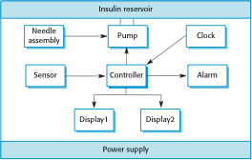
Insulin pump hardware architecture

Slide 28
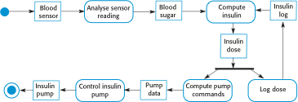
Activity model of the insulin pump

Slide 29
Key points
Software engineering is an engineering discipline that is concerned with all aspects of software production.
Essential software product attributes are maintainability, dependability and security, efficiency and acceptability.
The high-level activities of specification, development, validation and evolution are part of all software processes.
The fundamental notions of software engineering are universally applicable to all types of system development.

Slide 30
Key points
There are many different types of system and each requires appropriate software engineering tools and techniques for their development.
The fundamental ideas of software engineering are applicable to all types of software system.
Professional societies publish codes of conduct which set out the standards of behaviour expected of their members.

Slide 31
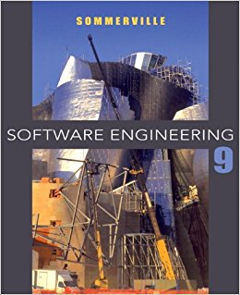
Reference
Ian Sommerville 2011, Software Engineering, 9th edition. Chapter 1,Chapter 2.

